Slide 1

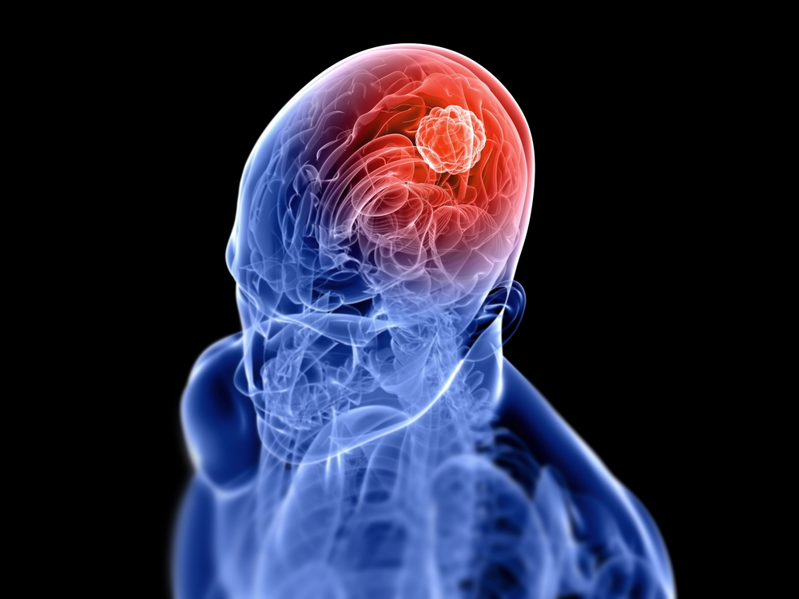
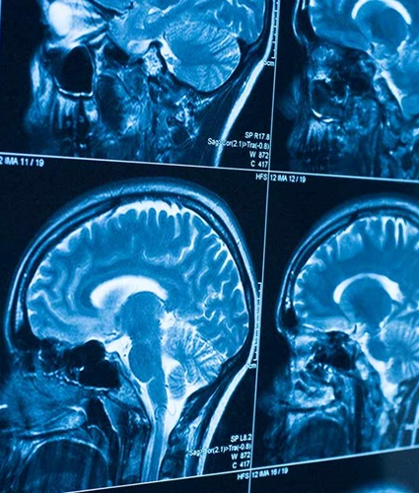
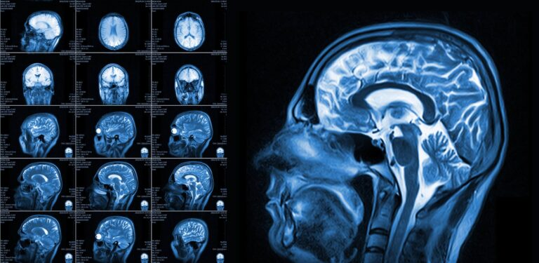
Brain Tumor Detection from MRI Images Using Convolutional Neural Networks
Presented By
Md Taofick Mahmoodur Rahaman
(221-35-847)
Supervisor: Dr. Rubaiyat Islam

Slide 2


Outlines
Research Gaps and Problem Statement
Objectives and Contribution
Research Scope and Literature Review
Methodology
References

Slide 3
Research Gaps & Problem Statement
Research Gaps
High training accuracy, but low validation accuracy (overfitting).
Small / imbalanced datasets → poor generalization.
Focus mainly on binary classification, not multi-class.
Lack of explainable AI (XAI) for clinical trust.
Problem Statement
Existing CNN models for brain tumor detection are limited by overfitting, dataset imbalance, lack of interpretability, and weak generalization. ➡️ Need a robust, accurate, and explainable CNN-based framework.

Slide 4
Transition to objective
Need for a robust deep learning framework with both high accuracy and strong generalization.
Must include explainable AI tools to improve clinical adoption.
Aim to bridge the gap between research models and real-world medical use.

Slide 5
Objectives
Build a custom hybrid CNN model for multi-class brain tumor detection.
Apply advanced preprocessing & augmentation for balanced dataset and reduced overfitting.
Achieve 98–99% accuracy for both training and validation datasets.
Use Grad-CAM visualization to explain model predictions.
Deliver a scalable and efficient framework suitable for clinical practice.

Slide 6
Research Scope
In This Study:
Covers MRI-based brain tumor classification (Glioma, Meningioma, Pituitary).
Uses custom CNN architecture with preprocessing & augmentation.
Performance validated using benchmark datasets (e.g., Kaggle Brain MRI Dataset).
Evaluation Metrics: Accuracy, Precision, Recall, F1-score, Grad-CAM visualization.
Not in Scope:
Non-MRI imaging techniques (e.g., CT scans, PET).
Tumor segmentation (pixel-level) beyond classification.
Real-time clinical deployment (future work).

Slide 7
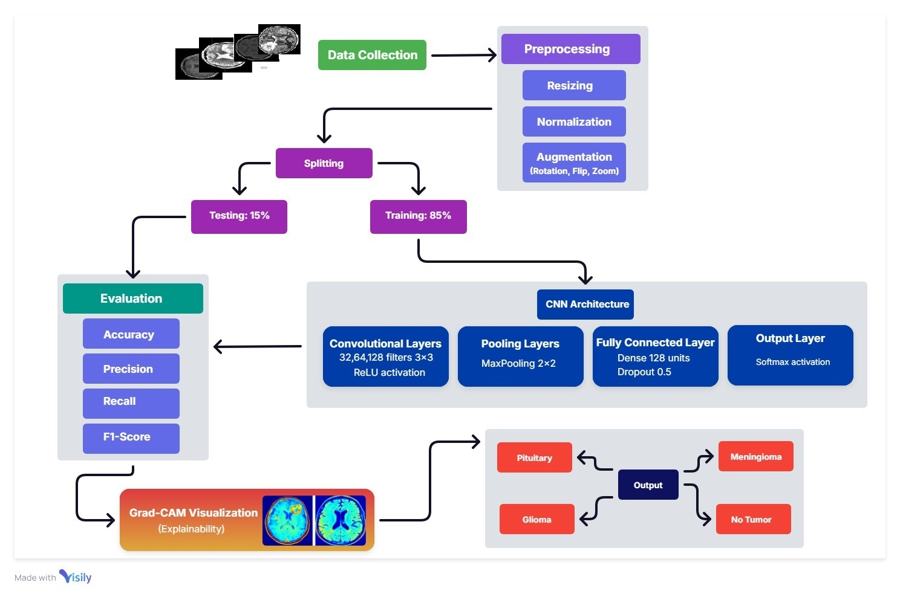
Methodology

Slide 8
References
Saeedi, Soheila, et al. "MRI-based brain tumor detection using convolutional deep learning methods and chosen machine learning techniques." BMC Medical Informatics and Decision Making 23.1 (2023): 16.
Asiri, Abdullah A., et al. "Brain tumor detection and classification using fine-tuned CNN with ResNet50 and U-Net model: A study on TCGA-LGG and TCIA dataset for MRI applications." Life 13.7 (2023): 1449.
Khan, Md Saikat Islam, et al. "Accurate brain tumor detection using deep convolutional neural network." Computational and structural biotechnology journal 20 (2022): 4733-4745.
Vijay, Vasupradha, A. R. Kavitha, and S. Roselene Rebecca. "Automated brain tumor segmentation and detection in MRI using enhanced Darwinian particle swarm optimization (EDPSO)." Procedia Computer Science 92 (2016): 475-480.
Kumar, Sunil, Renu Dhir, and Nisha Chaurasia. "Brain tumor detection analysis using CNN: a review." 2021 international conference on artificial intelligence and smart systems (ICAIS). IEEE, 2021.
Polat, Özlem, Zümray Dokur, and Tamer Ölmez. "Brain tumor classification by using a novel convolutional neural network structure." International Journal of Imaging Systems and Technology 32.5 (2022): 1646-1660.

Slide 9
THANK YOU

Slide 10

Question ???

